Slide 1
VA COVID-19 screening tool
From email to shipping product in 12 calendar days!
Martha Wilkes
June 2020

Slide 2
Day 1: Friday, May 8 Email arrives from Durham VA Medical Center
“Covid ideas” inbox
Chief of Staff’s son (recent college grad) created a screening tool
Going to start using it on Monday
Could/should DEPO (Charles Worthington’s team) help roll it out nationwide?
Team of 7 assembled
Since I’m in Chapel Hill, I volunteer to observe first-hand

Slide 3
Day 2: Saturday, May 9 First brief field visit: “before” state

Slide 4
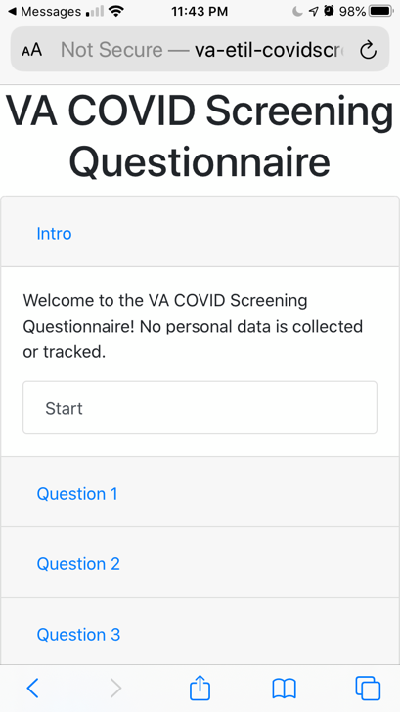
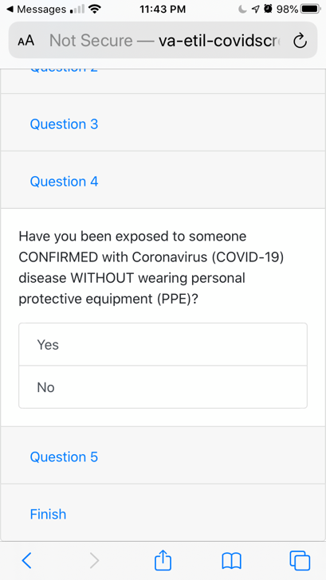
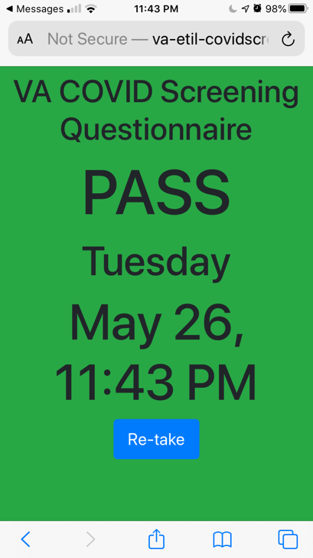
Day 2: Saturday, May 9 First brief field visit
Kim the pulmonology therapist
Showed me her phone

Slide 5
Day 4: Monday, May 11 Second field visit
Day One of ScreenPass operations
Stacy the screener asks everyone questions
Round dot stickers

Slide 6
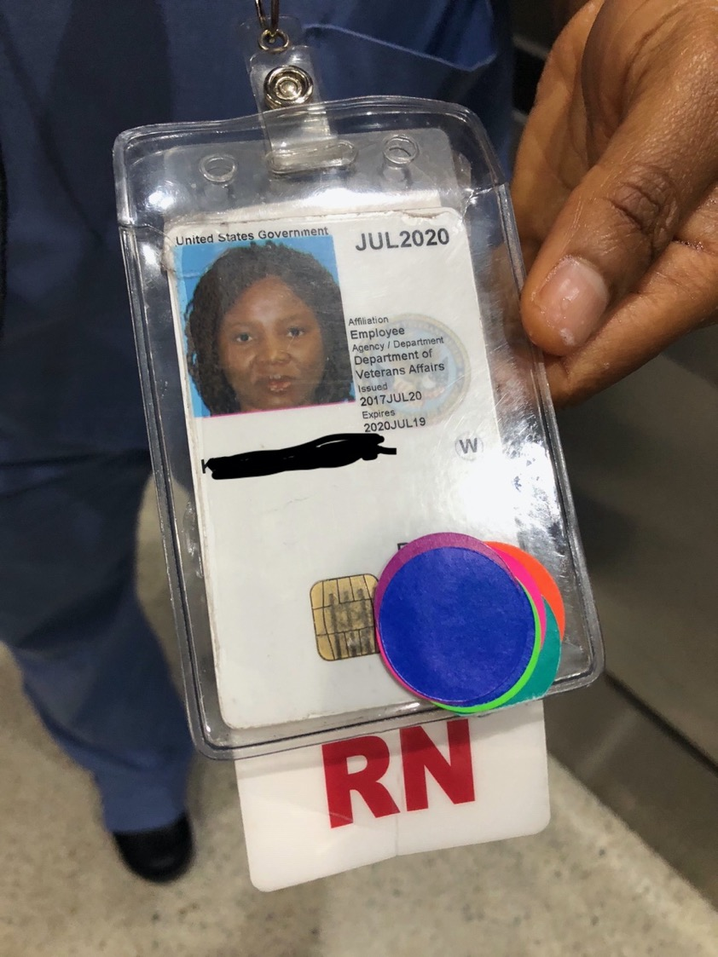
Day 4: Monday, May 11 Second field visit
Employees have a rainbow of stickers
Met with Durham stakeholders
“National” visitor

Slide 7
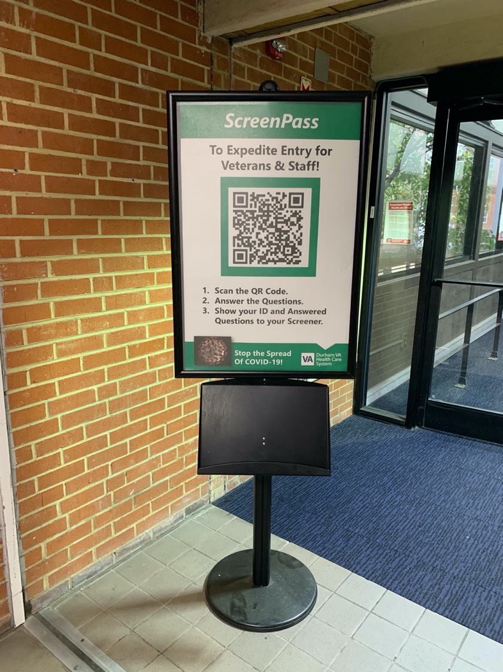
Day 5: Tuesday, May 12 Third field visit
Second day of ScreenPass operations
Bright and early at 7:00
Employees told to download QR code reader

Slide 8
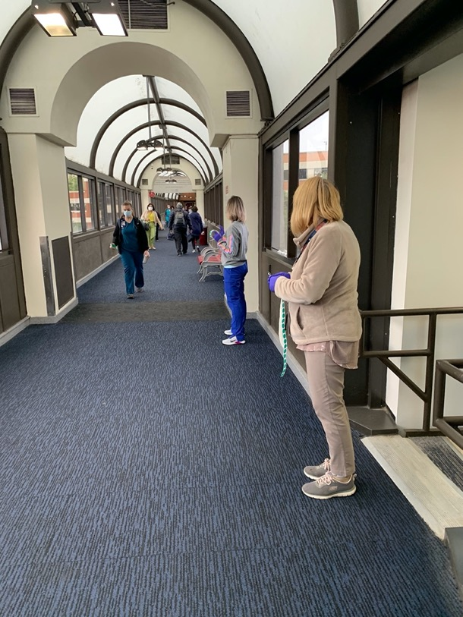
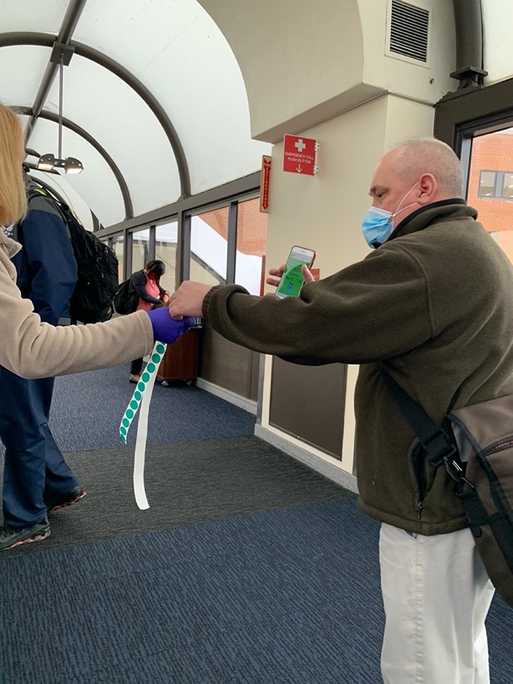
Day 5: Tuesday, May 12 Third field visit, 7-8 am, ~400 employees
Status | Users
Did not use app | 298
Successful with app | 81
Successful with app with additional help | 15
App did not work for them | 6

Slide 9
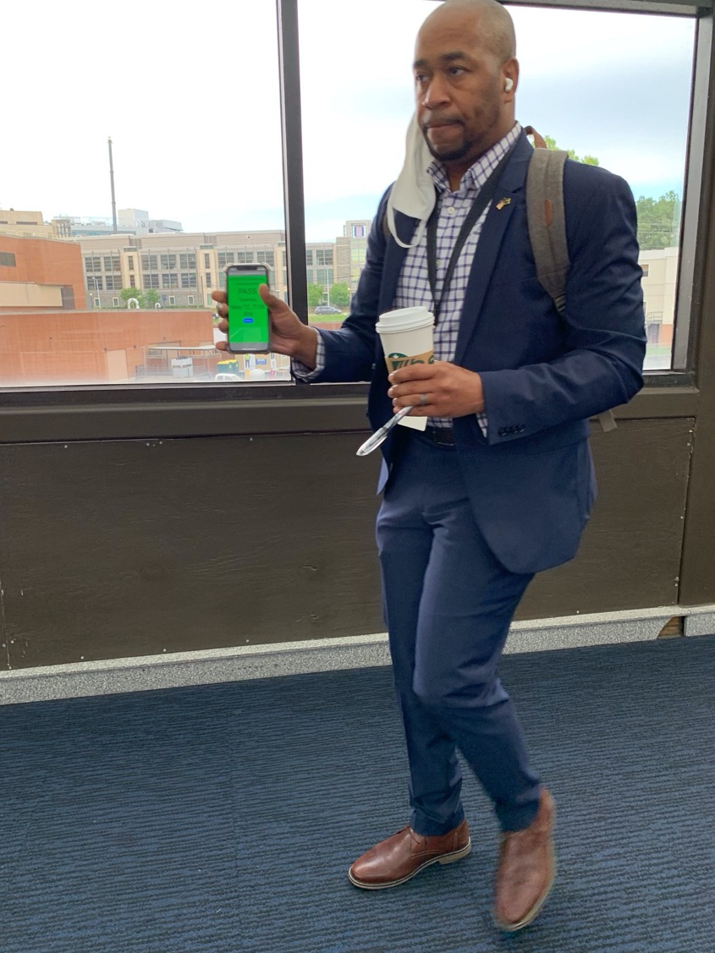
Day 5: Tuesday, May 12 Third field visit
Folks have their hands full
Folks who used the app successfully really liked it
Much faster than in-person questions
QR code reader not 100% reliable

Slide 10
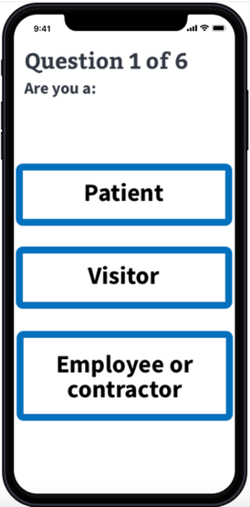
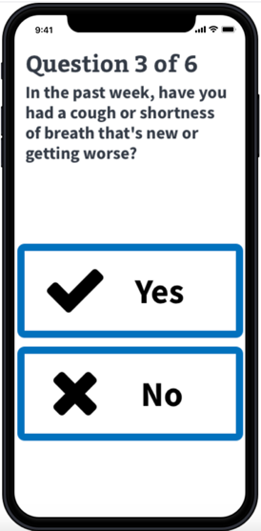
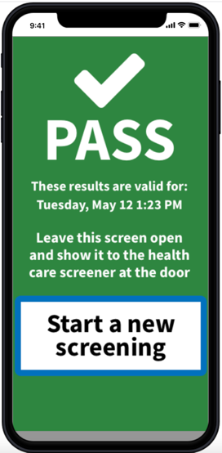
Day 5: Tuesday, May 12 afternoon Back at the computer
Created a clickable prototype
Content expert took over the questions
Developers started coding

Slide 11
Days 6-10: Wednesday, May 13-17 Testing and iteration
Guerilla usability testing
Accessibility review
Feedback from everyone
Developers continued coding
We planned a usability test on Monday…but would we use the prototype or real code???

Slide 12
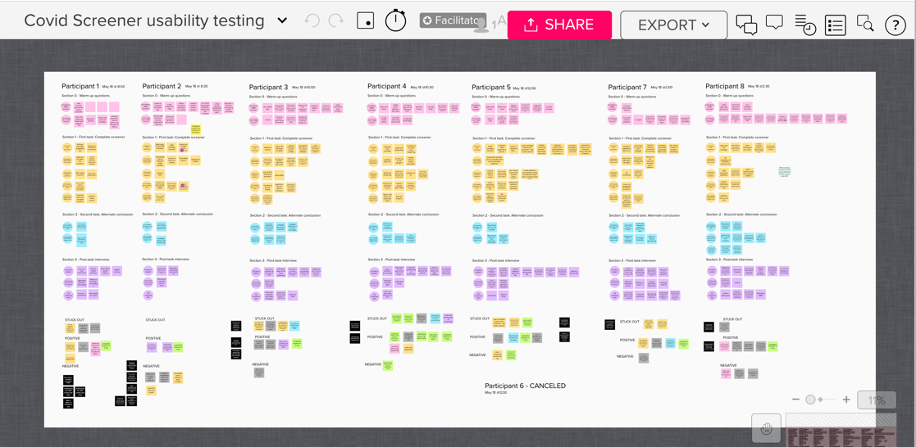
Day 11: Monday May 18 Usability testing with Vets, real code on phones
“If you’re doing this from your vehicle, then you are at a safe distance from staff and others.”
“Less stress having it in this format.”
“Straight and to the point. Very easy to answer these questions.”

Slide 13
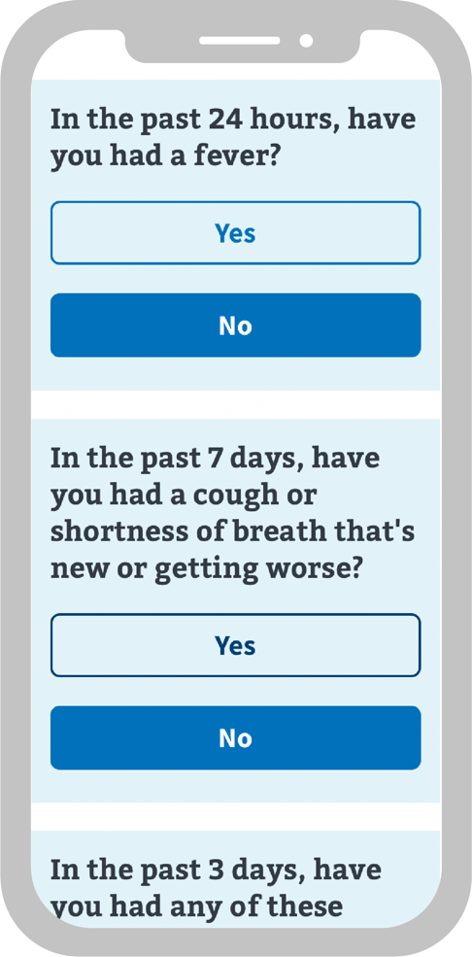
Day 12: Wednesday, May 20 Shipped to staging!
Try it for yourself now!
Text screen to 53079

Slide 14
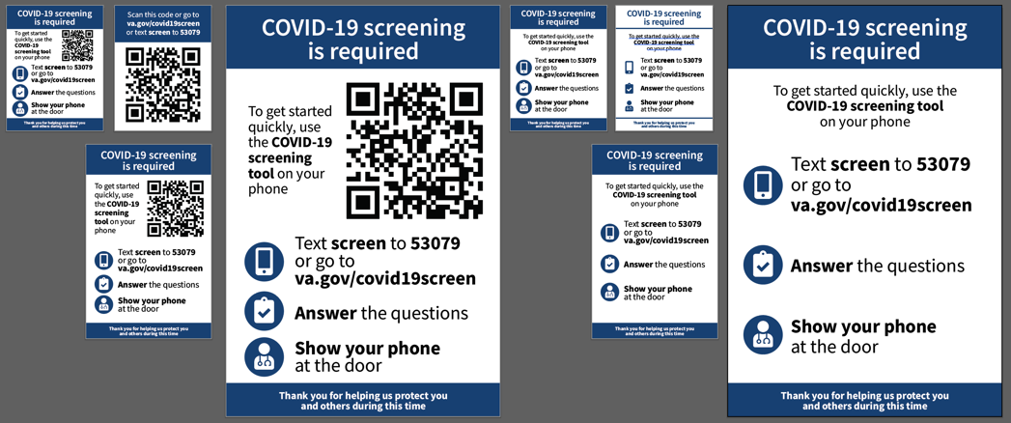
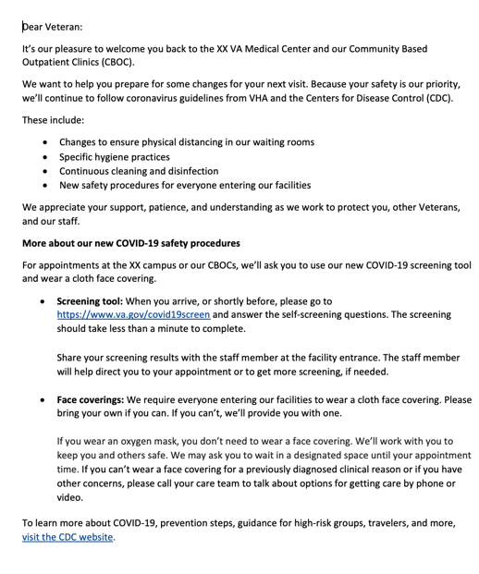
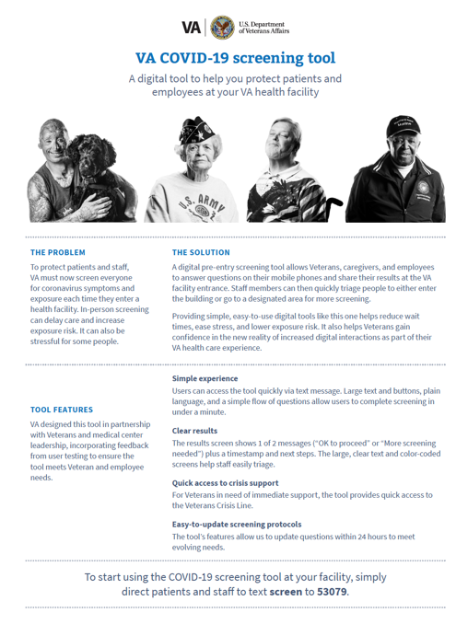
Next steps: Rollout and service design
“Quick and efficient”
“Love to implement ASAP”
“Kudos to for getting this stood up so rapidly”
Posters and flyers, 1-pager, reminder letter, social media drafts

Slide 15
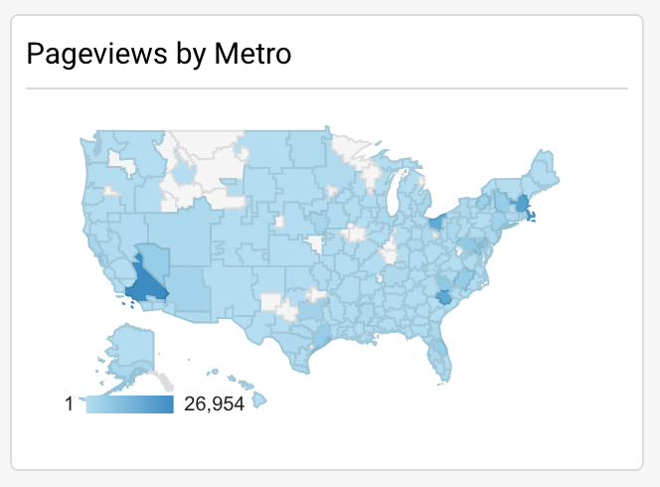
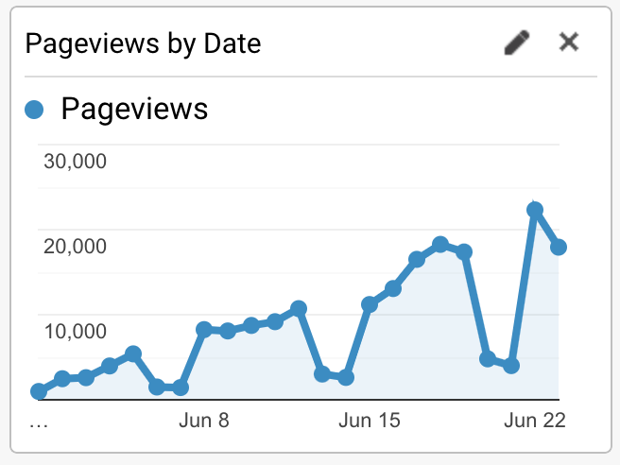
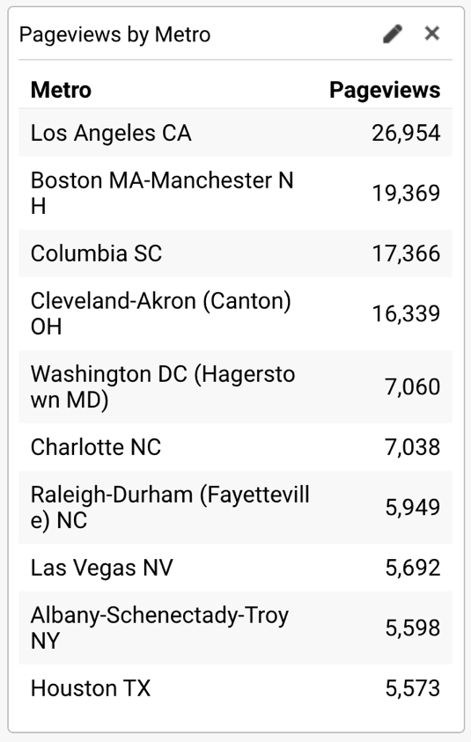
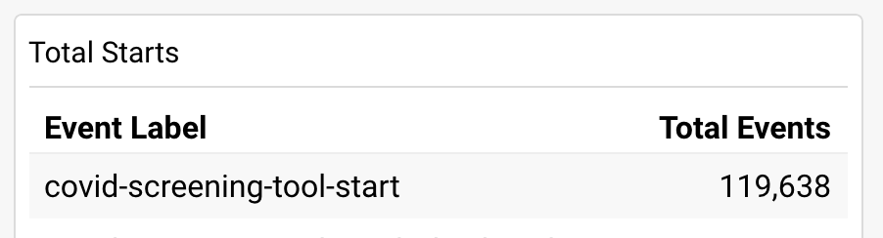
Google Analytics – June 1-23

Slide 16
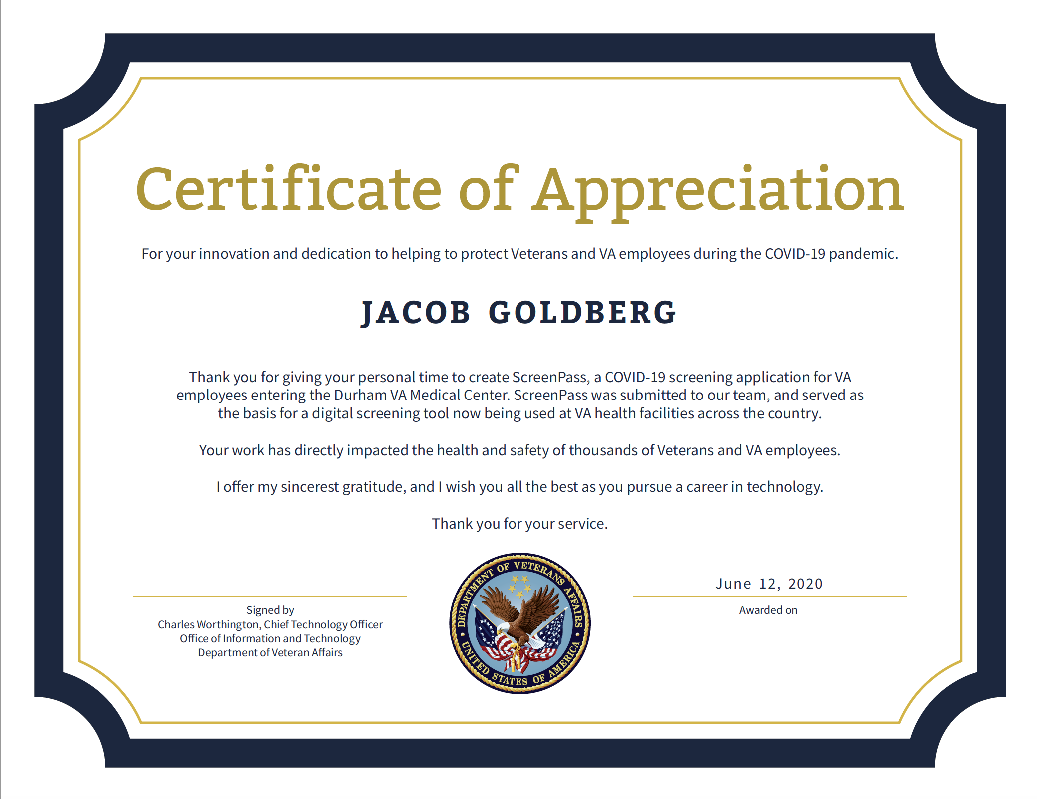
Credit where credit is due

Slide 17
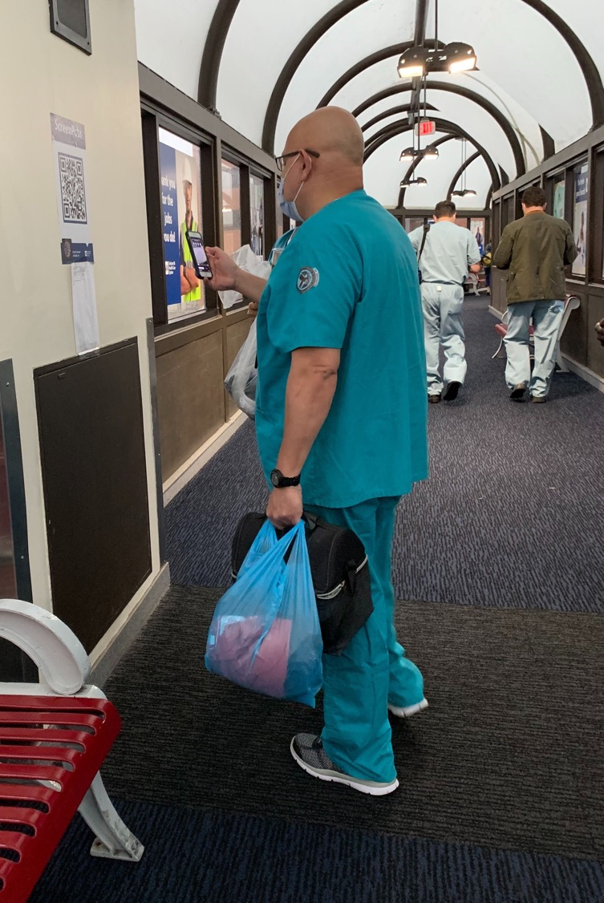
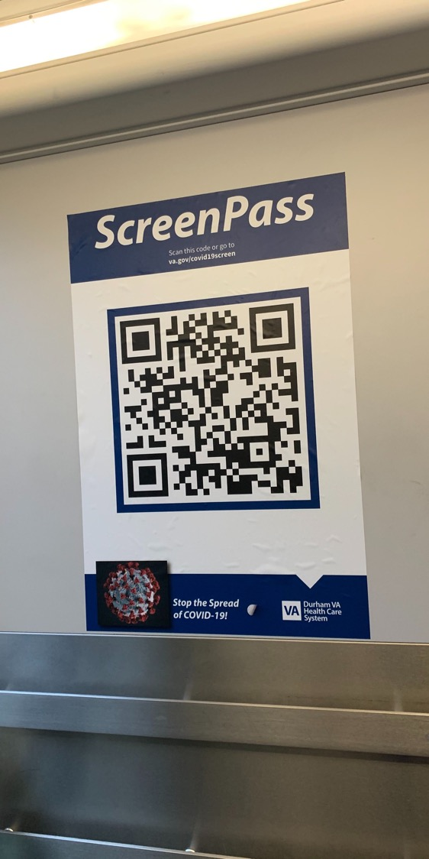
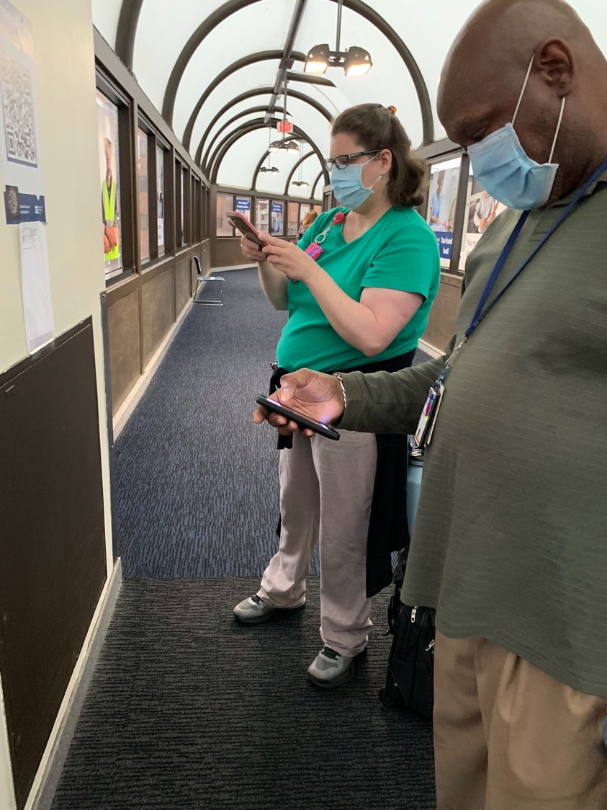

Slide 18
